Slide 1

STUDENT HOSTEL MANAGEMENT SYSTEM
Team Members:
A. SATYA - 25B11CS020
B. ASRITHA - 25B11CS136
B. SRUTHI - 25B11CS103
K. ANUSHA - 25B11CS498

Slide 2
Real-World Problem
Managing student hostel details manually can be difficult.
It is time-consuming to manage students, rooms, fees, and allocations.
Manual records may cause errors and duplicate entries.
It can be difficult to quickly check room availability and student details.
Our system helps manage hostel information in an organized and efficient way.

Slide 3
Why the Project is Needed
To make hostel management faster and easier.
To maintain student and room details in one place.
To quickly check room availability and room allocation.
To reduce manual work and errors.
To easily manage hostel fees and student records.

Slide 4
Objectives of the project
To maintain student details in a database.
To manage hostel rooms and room availability.
To manage student room allocation.
To maintain hostel fee and payment details.
To reduce manual work and data entry errors.
To provide quick and accurate hostel records.

Slide 5
Functional Requirements
Add and manage student details.
Add and manage room details.
Check room availability.
Allocate rooms to students.
Record hostel fee and payment details.
Generate and view student and hostel records.

Slide 6
Non-Functional Requirements
Security: Student and payment information should be protected.
Reliability: The system should provide accurate information.
Performance: The system should respond quickly.
Usability: The system should be simple and easy to use.
Data Integrity: Student and hostel records should remain correct and consistent.

Slide 7
End Users of the System
Hostel Warden: Manages students, rooms, and hostel records.
Hostel Staff: Handles room allocation and student information.
Students: Can view room details and hostel-related information.
Administrator: Manages the database and overall system.

Slide 8
Entities and Attributes
Stores hostel room information.
Room_ID — Primary Key
Room_Number
Room_Type
Room_Status
Capcity-Derived Attribute
Room
Stores student information.
Student_ID — Primary Key
Student_Name
Phone
Email
Department
Address – Composite Attribute
Street
City
PinCode
Student
Allocation
Stores hostel fee information.
Payment_ID — Primary Key
Student_ID — Foreign Key
Payment_Date
Amount
Payment_Status
Stores room allocation details.
Allocation_ID__Primary Key
Student_ID__Foreign Key
Room_ID — Foreign Key
Allocation_Date
Payment

Slide 9
Entities and Attributes
Stores hostel fee information.
Payment_ID — Primary Key
Student_ID — Foreign Key
Payment_Date
Amount
Payment_Status
Payment
Hostel_ID — Primary Key
Hostel_Name
Location
Warden_ID — Primary Key
Warden_Name
Phone
Email
Hostel
Warden

Slide 10
Relationships
1. Student — Allocation
Relationship: Gets/Receives
One student can have room allocation records.
2. Room — Allocation
Relationship: Assigned
A room can be assigned to students over different periods.
3. Student — Payment
Relationship: Makes/Pays
A student can make payments for hostel fees.
2. Allocation — Payment
Relationship: One Allocation can have many Payment records.
2. Room — Warden
Relationship: Assigned
Many Rooms can be managed by one Warden.
3. Student — Hostel
Relationship: Assigned
Many Students can belong to one Hostel.

Slide 11
Database Schema
Student(Student_ID, Student_Name, Phone, Email, Department)
Room(Room_ID, Room_Number, Room_Type, Room_Status)
Allocation(Allocation_ID, Student_ID, Room_ID, Allocation_Date)
Payment(Payment_ID, Student_ID, Payment_Date, Amount, Payment_Status)
Hostel(Hostel_ID, Hostel_Name, Location)
Warden(Warden_ID, Warden_Name, Phone, Email)

Slide 12
Cardinality
Student — Allocation: 1:M
One student can have many allocation records.
Room — Allocation: 1:M
One room can have many allocation records over time.
Student — Payment: 1:M
One student can make many payments.

Slide 13
Cardinality
Allocation — Payment: 1:M
One allocation can have many payment records.
Student — Hostel: M:1
Many students can belong to one hostel.
Room — Warden: M:1
Multiple rooms can be managed by one warden.

Slide 14
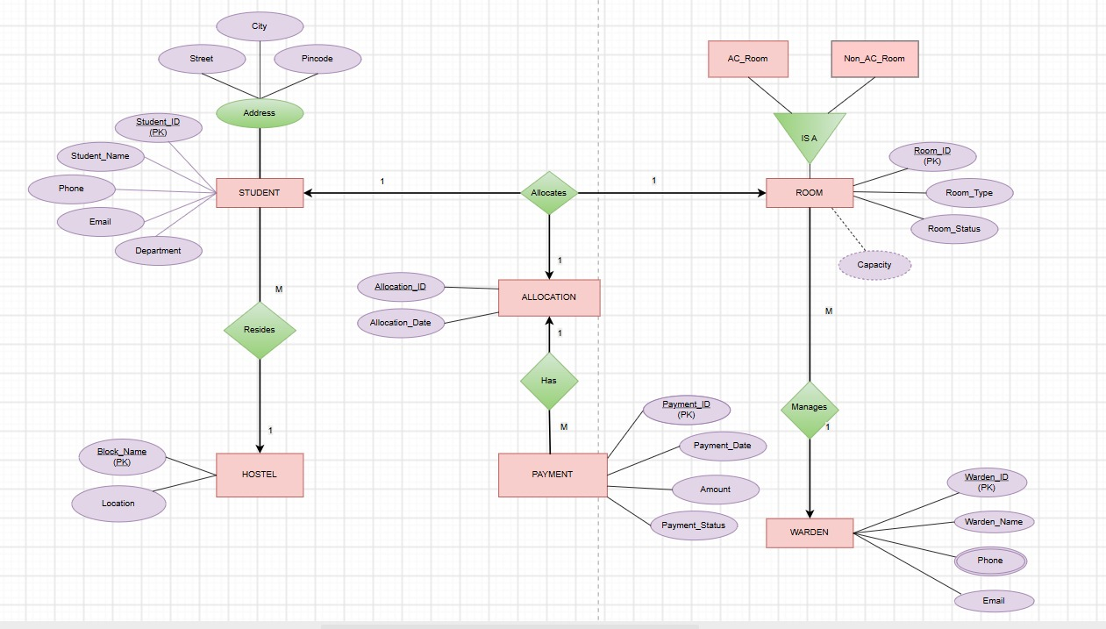
ER - DIAGRAM

Slide 15
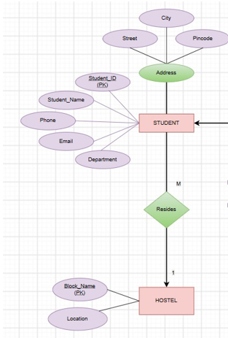
TABLES CREATION
Hostel Table
CREATE TABLE HOSTELS11 (
Hostel_ID VARCHAR2(10) PRIMARY KEY,
Block_Name VARCHAR2(50) NOT NULL,
Location VARCHAR2(100)
);
Relationship Table Name: STUDENT_HOSTEL
SELECT Student_ID, Hostel_ID
FROM STUDENTS11;

Slide 16
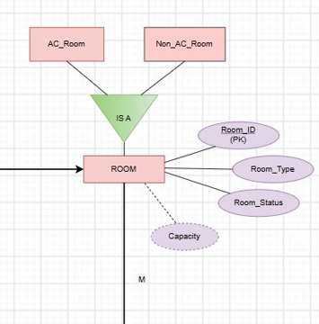
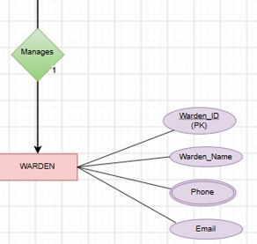
Warden Table
CREATE TABLE WARDENS11 (
Warden_ID NUMBER PRIMARY KEY,
Warden_Name VARCHAR2(100) NOT NULL,
Phone VARCHAR2(15),
Email VARCHAR2(100)
);
Relationship Table Name: ROOM_WARDEN
SELECT Room_ID, Warden_ID
FROM ROOMS11;

Slide 17
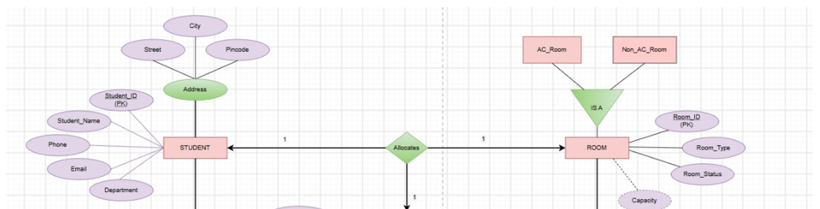
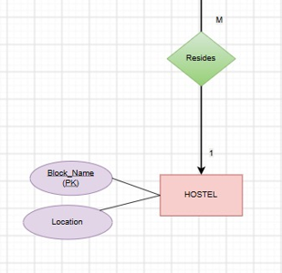
Student table
CREATE TABLE STUDENTS11 (
Student_ID NUMBER PRIMARY KEY,
Student_Name VARCHAR2(100) NOT NULL,
Phone VARCHAR2(15),
Email VARCHAR2(100),
Department VARCHAR2(50),
Street VARCHAR2(100),
City VARCHAR2(50),
Pincode VARCHAR2(10),
Hostel_ID VARCHAR2(10),
FOREIGN KEY (Hostel_ID)
REFERENCES HOSTELS11(Hostel_ID)
);
Relationship Table Name: STUDENT_PAYMENT
SELECT Student_ID, Payment_ID, Payment_Date, Amount, Payment_Status
FROM PAYMENTS11;

Slide 18
Room Table
CREATE TABLE ROOMS11 (
Room_ID NUMBER PRIMARY KEY,
Room_Type VARCHAR2(20),
Room_Status VARCHAR2(20),
Capacity NUMBER,
Warden_ID NUMBER,
FOREIGN KEY (Warden_ID)
REFERENCES WARDENS11(Warden_ID)
);
Relationship Table Name: ROOM_ALLOCATION
SELECT Room_ID, Allocation_ID, Student_ID, Allocation_Date
FROM ALLOCATIONS11;

Slide 19
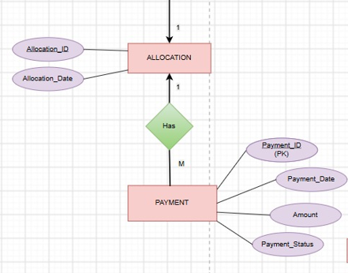
Allocation Table
CREATE TABLE ALLOCATIONS11 (
Allocation_ID NUMBER PRIMARY KEY,
Allocation_Date DATE,
Student_ID NUMBER,
Room_ID NUMBER,
FOREIGN KEY (Student_ID)
REFERENCES STUDENTS11(Student_ID),
FOREIGN KEY (Room_ID)
REFERENCES ROOMS11(Room_ID)
);
Relationship Table Name: STUDENT_ALLOCATION
SELECT Student_ID, Hostel_ID
FROM STUDENTS11;
SELECT Student_ID, Allocation_ID, Room_ID, Allocation_Date
FROM ALLOCATIONS11;

Slide 20
Payment table
CREATE TABLE PAYMENTS11 (
Payment_ID NUMBER PRIMARY KEY,
Student_ID NUMBER,
Payment_Date DATE,
Amount NUMBER(10,2),
Payment_Status VARCHAR2(20),
FOREIGN KEY (Student_ID)
REFERENCES STUDENTS11(Student_ID)
);
Relationship Table Name: ALLOCATION_PAYMENT
SELECT a.Allocation_ID,
a.Student_ID,
a.Room_ID,
p.Payment_ID,
p.Payment_Date,
p.Amount,
p.Payment_Status
FROM ALLOCATIONS11 a
JOIN PAYMENTS11 p
ON a.Student_ID = p.Student_ID;

Slide 21
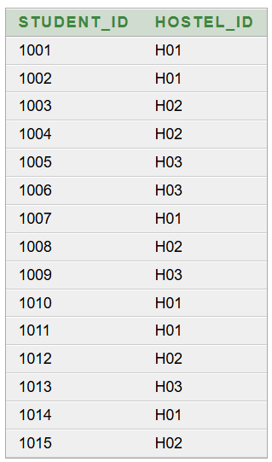
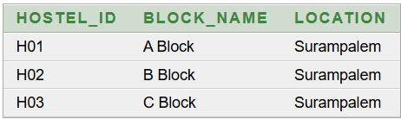
Hostel Table Output:
Relationship Table Output: STUDENT_HOSTEL

Slide 22
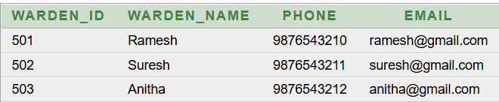
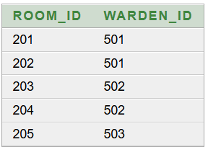
Warden Table Output:
Relationship Table Output: ROOM_WARDEN

Slide 23
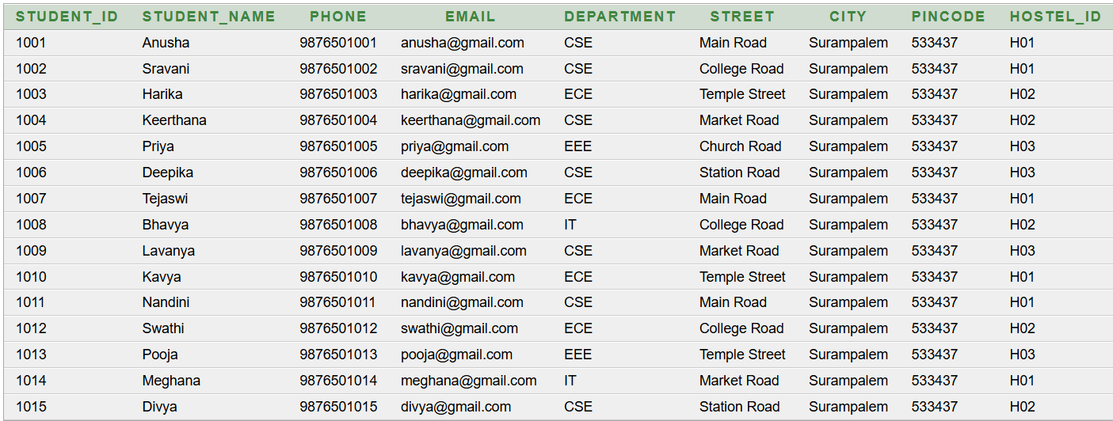
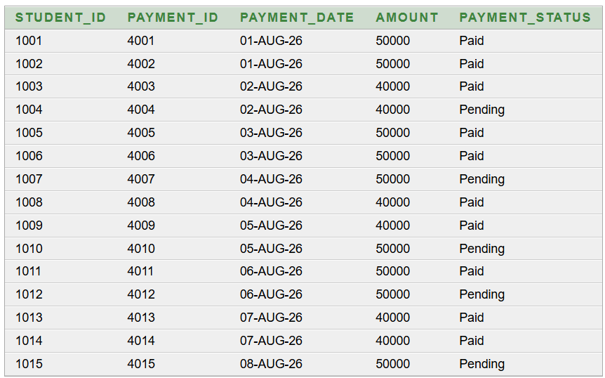
Student Table Output:
Relationship Table Output: STUDENT_PAYMENT

Slide 24
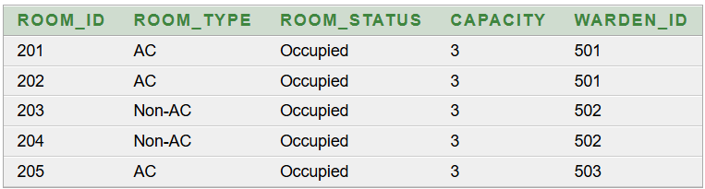
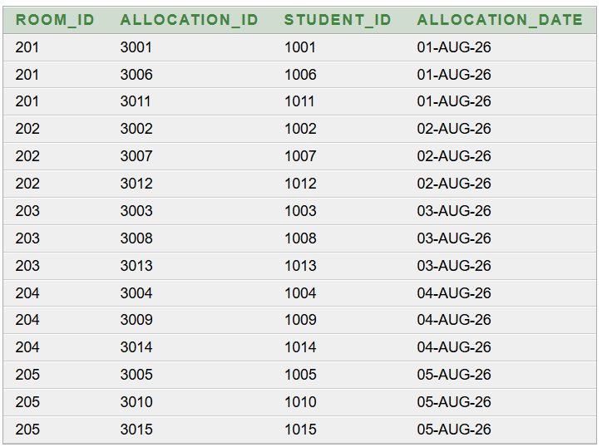
Room Table Output:
Relationship Table Output: ROOM_ALLOCATION

Slide 25
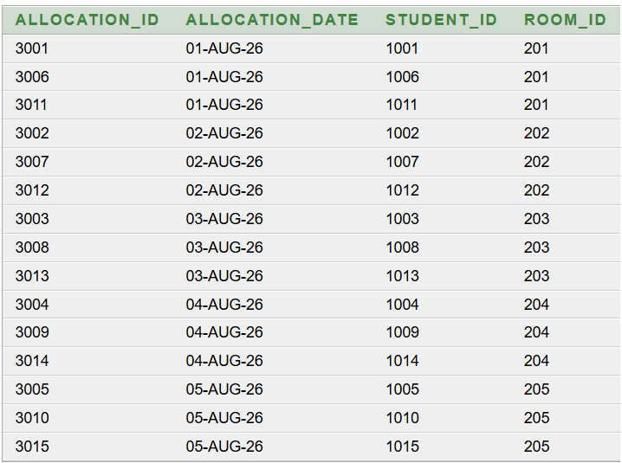
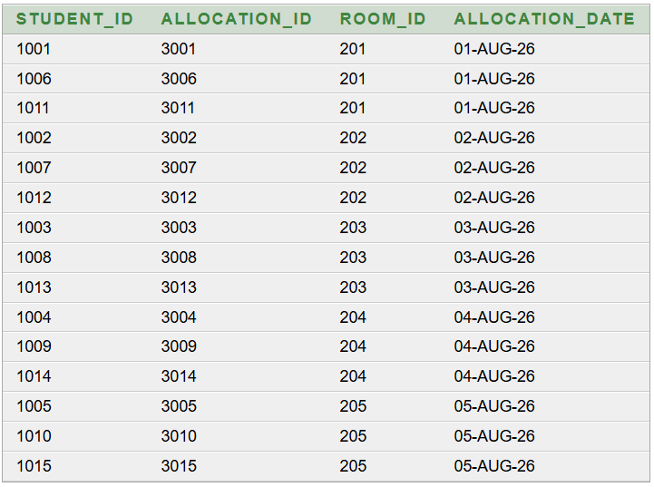
Allocation Table Output:
Relationship Table Output: STUDENT_ALLOCATION

Slide 26
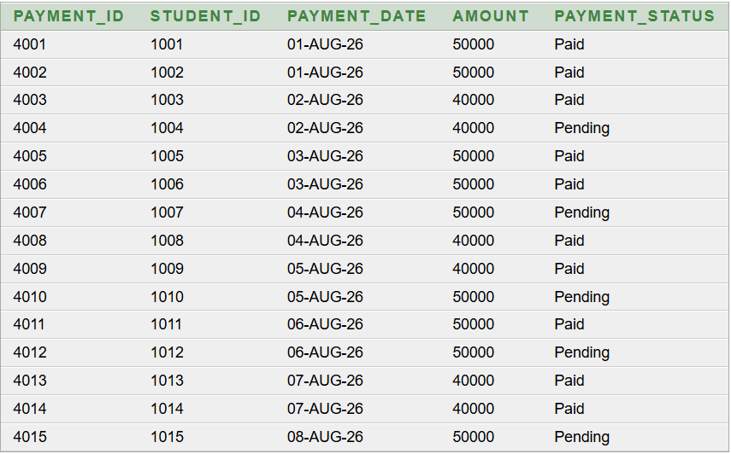
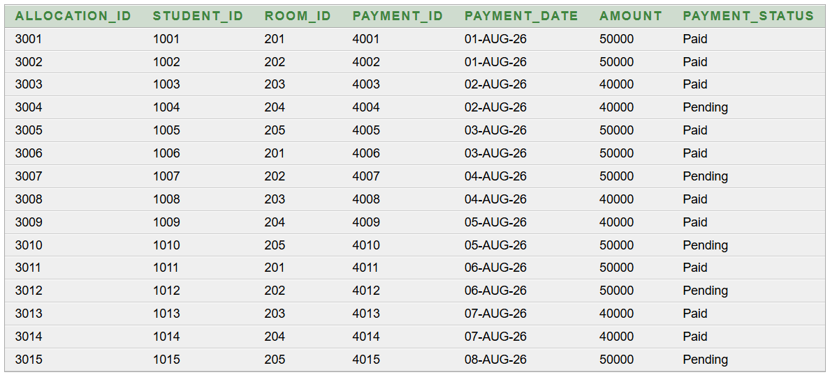
Payment Table Output:
Relationship Table Output: ALLOCATION_PAYMENT

Slide 27
PRIMARY KEYS, FOREIGN KEYS & CONSTRAINTS
Primary Keys
HOSTELS11 → Hostel_ID
WARDENS11 → Warden_ID
STUDENTS11 → Student_ID
ROOMS11 → Room_ID
ALLOCATIONS11 → Allocation_ID
PAYMENTS11 → Payment_ID
Foreign Keys
STUDENTS11.Hostel_ID → HOSTELS11.Hostel_ID
ROOMS11.Warden_ID → WARDENS11.Warden_ID
ALLOCATIONS11.Student_ID → STUDENTS11.Student_ID
ALLOCATIONS11.Room_ID → ROOMS11.Room_ID
PAYMENTS11.Student_ID → STUDENTS11.Student_ID
Constraints
PRIMARY KEY
FOREIGN KEY
NOT NULL
VARCHAR2
NUMBER
NUMBER(10,2)

Slide 28
QUERIES
1.Basic Queries
Query 1: Display all students
SQL > SELECT * FROM STUDENTS11;

Slide 29
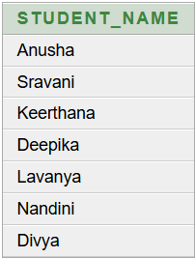
Query 2: Display students belonging to CSE
SELECT Student_Name
FROM STUDENTS11
WHERE Department='CSE';

Slide 30
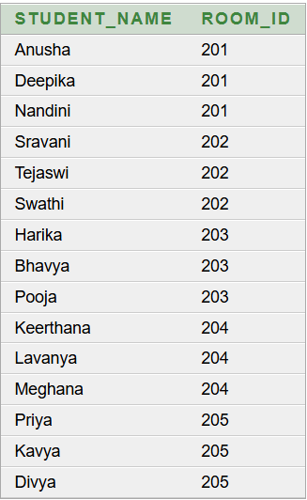
Query 3: Write a query to display the student names along with their room numbers.
SELECT s.Student_Name, a.Room_ID
FROM STUDENTS11 s, ALLOCATIONS11 a
WHERE s.Student_ID=a.Student_ID;

Slide 31
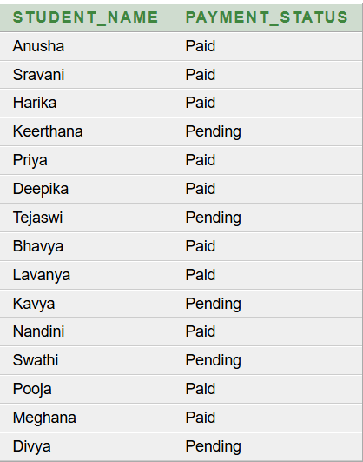
Query 4: Write a query to display student names along with their payment status.
SELECT s.Student_Name, p.Payment_Status
FROM STUDENTS11 s, PAYMENTS11 p
WHERE s.Student_ID=p.Student_ID;

Slide 32
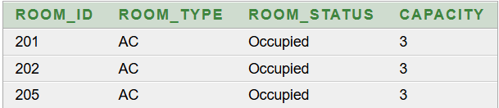
Query 5: Write a query to display the details of AC rooms.
SELECT Room_ID, Room_Type, Room_Status, Capacity
FROM ROOMS11
WHERE Room_Type='AC';

Slide 33
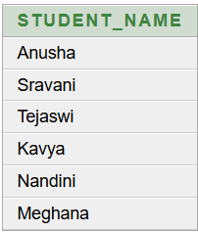
Query 6: Write a query to find the names of students staying in hostel H01.
SELECT Student_Name
FROM STUDENTS11
WHERE Hostel_ID='H01';

Slide 34
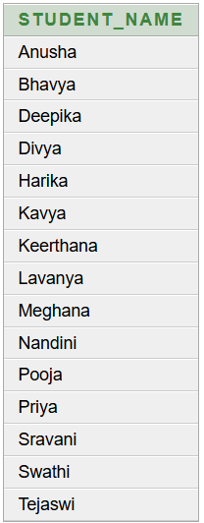
Query 7: Write a query to display student names in ascending order.
SELECT Student_Name
FROM STUDENTS11
ORDER BY Student_Name;

Slide 35
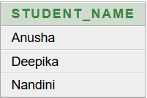
ADVANCED QURIES
Query 1: Write a query to find the names of students who are allocated to Room 201.
SELECT s.Student_Name
FROM STUDENTS11 s
WHERE s.Student_ID IN
(
SELECT a.Student_ID
FROM ALLOCATIONS11 a
WHERE a.Room_ID=201
);

Slide 36
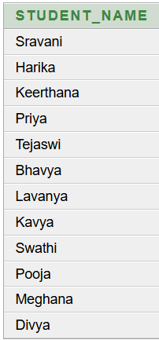
Query 2: Write a query to find the names of
students who are not allocated to Room 201.
SELECT s.Student_Name
FROM STUDENTS11 s
WHERE s.Student_ID NOT IN
(
SELECT a.Student_ID
FROM ALLOCATIONS11 a
WHERE a.Room_ID=201
);

Slide 37
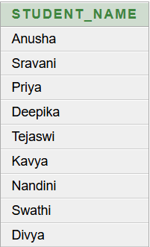
Query 3:Write a query to find the names of students who are staying in AC rooms.
SELECT s.Student_Name
FROM STUDENTS11 s
WHERE s.Student_ID IN
(
SELECT a.Student_ID
FROM ALLOCATIONS11 a
WHERE a.Room_ID IN
(
SELECT r.Room_ID
FROM ROOMS11 r
WHERE r.Room_Type='AC'
)
);

Slide 38
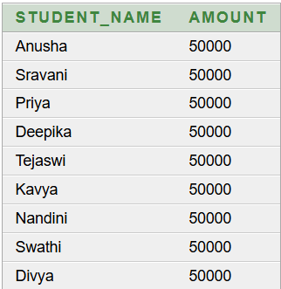
Query 4:Write a query to find the student who paid the highest amount.
SELECT s.Student_Name, p.Amount
FROM STUDENTS11 s, PAYMENTS11 p
WHERE s.Student_ID=p.Student_ID
AND p.Amount>=ALL
(
SELECT p1.Amount
FROM PAYMENTS11 p1
);

Slide 39
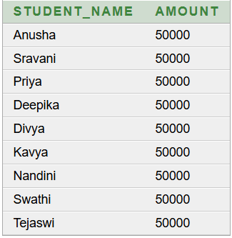
Query 5:Write a query to find students who paid more than at least one student who paid ₹40,000.
SELECT s.Student_Name, p.Amount
FROM STUDENTS11 s, PAYMENTS11 p
WHERE s.Student_ID=p.Student_ID
AND p.Amount>ANY
(
SELECT p1.Amount
FROM PAYMENTS11 p1
WHERE p1.Amount=40000
);

Slide 40
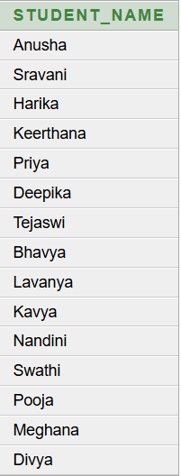
Query 6:Write a query to find the names of students who have made a payment.
SELECT s.Student_Name
FROM STUDENTS11 s
WHERE EXISTS
(
SELECT *
FROM PAYMENTS11 p
WHERE p.Student_ID=s.Student_ID
);

Slide 41
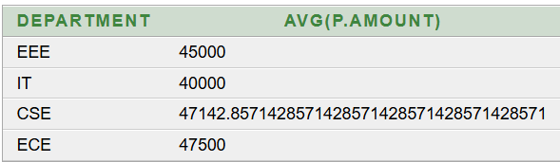
Query 7:Write a query to find the average payment amount for each department.
SELECT s.Department, AVG(p.Amount)
FROM STUDENTS11 s, PAYMENTS11 p
WHERE s.Student_ID=p.Student_ID
GROUP BY s.Department;

Slide 42
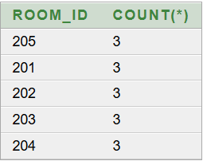
Query 8:Write a query to find the rooms having at least 3 students.
SELECT a.Room_ID, COUNT(*)
FROM ALLOCATIONS11 a
GROUP BY a.Room_ID
HAVING COUNT(*)>=3;

Slide 43
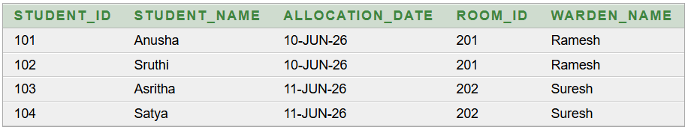
FIRST NORMAL FORM
FD:-
Student_ID → Student_Name
Student_ID, Allocation_Date → Room_ID, Warden_Name
FIRST( Student_ID, Student_Name, Allocation_Date, Room_ID, Warden_Name )
PRIMARY KEY(Student_ID, Allocation_Date)

Slide 44
1NF:
• All attributes contain single values.
• A combined relation is created with a composite primary key.
• Student and allocation information are stored together.
Redundancy / Anomalies in 1NF
• Student information may be repeated for multiple allocation records.
• Warden_Name may be repeated for the same room.
• Update anomaly may occur when repeated information is changed.
• Delete anomaly may occur when deleting an allocation also removes the only stored information about a student.
• Insert anomaly may occur when student information cannot be stored without allocation information.

Slide 45
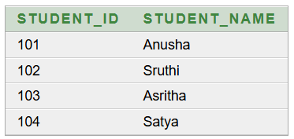
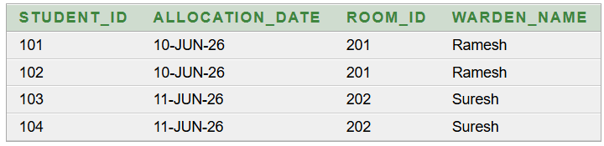
SECOND NORMAL FORM
STUDENT_2NF_FINAL(Student_ID, Student_Name)
PRIMARY KEY(Student_ID)
ALLOCATION_2NF_FINAL(Student_ID, Allocation_Date, Room_ID, Warden_Name)
PRIMARY KEY(Student_ID, Allocation_Date)
FOREIGN KEY(Student_ID) REFERENCES STUDENT_2NF_FINAL(Student_ID)
FD:
Student_ID → Student_Name
(Student_ID, Allocation_Date) → Room_ID, Warden_Name

Slide 46
2NF:
• The partial dependency Student_ID → Student_Name is removed.
• Student details are separated into STUDENT_2NF_FINAL.
• Allocation details are stored in ALLOCATION_2NF_FINAL.
• Student_ID is used as a foreign key to connect the two tables.
Redundancy / Anomalies removed in 2NF
• Repetition of Student_Name is reduced.
• Update anomaly for Student_Name is removed.
• Student information can be inserted independently.
• Deleting an allocation does not delete the student's basic information.
Lossless Join:
The original relation FIRST is decomposed into two relations, STUDENT_2NF_FINAL and ALLOCATION_2NF_FINAL. These two relations have Student_ID as the common attribute. When we join both relations using Student_ID, the original FIRST relation can be reconstructed without losing any information. Therefore, this decomposition is called a Lossless Join.

Slide 47
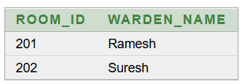
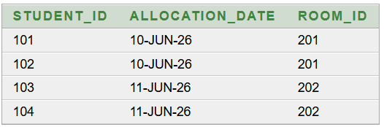
THIRD NORMAL FORM
ALLOCATION_DETAILS_3NF(Student_ID, Allocation_Date, Room_ID)
PRIMARY KEY(Student_ID, Allocation_Date)
ROOM_DETAILS_3NF(Room_ID, Warden_Name)
PRIMARY KEY(Room_ID)
FOREIGN KEY(Room_ID) REFERENCES ROOM_DETAILS_3NF(Room_ID)
FD:
(Student_ID, Allocation_Date) → Room_ID
Room_ID → Warden_Name
Transitive Dependency:
(Student_ID, Allocation_Date) → Room_ID
Room_ID → Warden_Name
Therefore,
(Student_ID, Allocation_Date) → Warden_Name

Slide 48
3NF:
• The transitive dependency is identified.
• Warden_Name is separated from the allocation relation.
• Room_ID determines Warden_Name in ROOM_DETAILS_3NF.
• The remaining non-key attributes depend directly on their table's primary key.
Redundancy / Anomalies removed in 3NF
• Repeated Warden_Name values are removed from allocation records.
• Update anomaly for Warden_Name is removed.
• Warden information can be maintained independently of allocation records.
• Deleting an allocation does not remove the room's warden information.
Lossless Join
The original relation ALLOCATION_2NF_FINAL is decomposed into two relations, ALLOCATION_DETAILS_3NF and ROOM_DETAILS_3NF. These two relations have Room_ID as the common attribute. When we join both relations using Room_ID, the original ALLOCATION_2NF_FINAL relation can be reconstructed without losing any information. Therefore, this decomposition is called a Lossless Join.

Slide 49
CONCLUSION:
The Student Hostel Management System helps to manage student, room, allocation, payment, hostel, and warden details in an organized way.
The database reduces manual work, data redundancy, and data entry errors.
Normalization from 1NF to 3NF helped us remove partial and transitive dependencies and reduce unnecessary repetition of data.
The decomposed tables maintain data consistency and integrity while supporting lossless joins.
Overall, the system provides a structured, reliable, and efficient database for managing hostel information.

Slide 50
Thank you

